Slide 1
Lempel-Ziv Compression Techniques
Classification of Lossless Compression techniques
Introduction to Lempel-Ziv Encoding: LZ77 & LZ78
LZ78 Encoding Algorithm
LZ78 Decoding Algorithm

Slide 2
Introduction to Lempel-Ziv Encoding
Data compression up until the late 1970's mainly directed towards creating better methodologies for Huffman coding.
An innovative, radically different method was introduced in1977 by Abraham Lempel and Jacob Ziv.
This technique (called Lempel-Ziv) actually consists of two considerably different algorithms, LZ77 and LZ78.
Due to patents, LZ77 and LZ78 led to many variants:
 |  | LZH | LZB | LZSS | LZR | LZ77 Variants
LZFG | LZJ | LZMW | LZT | LZC | LZW | LZ78 Variants

Slide 3
LZ77 (Sliding Window)
Search Buffer (Thousands of bytes long)
Look ahead Buffer (Tens of bytes long)
Text should be read from right to left in the buffer
The encoder check the symbol in Look ahead buffer with search buffer considered here as dictionary
Offset is the count from the dividing line between search and look ahead buffer.
Length is the span of string matched in look ahead buffer corresponding to search buffer
Symbol is the next character after the string match
The encoder select the longest match or if they are all the same length the last one found because the last one will be leaving the search buffer soon.

Slide 4
LZ77 (Sliding Window)
Dividing Line
Search Buffer (Dictionary)
Look ahead Buffer
Text Movement
Input Text : sir˽sid˽eastman˽easily˽teases˽sea˽sick˽seals
Note:- ˽ It represents space

Slide 5
LZ77 (Sliding Window)
Dividing Line
sir˽sid˽eastman˽easily˽teases˽sea˽sick˽seals
Search Buffer (Dictionary)
Size = 30 symbols (app)
Look ahead Buffer
Size = 10 symbols (app)
Text Movement
Encoding scheme (offset, length, next symbol)

Slide 6
LZ77 (Sliding Window)
Dividing Line
s
ir˽sid˽eastman˽easily˽teases˽sea˽sick˽seals
Search Buffer (Dictionary)
Look ahead Buffer
Text Movement
Encoding scheme: (0, 0, s)

Slide 7
LZ77 (Sliding Window)
Dividing Line
si
r˽sid˽eastman˽easily˽teases˽sea˽sick˽seals
Search Buffer (Dictionary)
Look ahead Buffer
Text Movement
Encoding scheme: (0, 0, s)
(0, 0, i )

Slide 8
LZ77 (Sliding Window)
Dividing Line
sir
˽sid˽eastman˽easily˽teases˽sea˽sick˽seals
Search Buffer (Dictionary)
Look ahead Buffer
Text Movement
Encoding scheme: (0, 0, s)
(0, 0, i )
(0, 0, r )

Slide 9
LZ77 (Sliding Window)
Dividing Line
sir ˽
sid˽eastman˽easily˽teases˽sea˽sick˽seals
Search Buffer (Dictionary)
Look ahead Buffer
Text Movement
Encoding scheme: (0, 0, s)
(0, 0, i )
(0, 0, r )
(0, 0, ˽ )

Slide 10
LZ77 (Sliding Window)
Dividing Line
sir ˽sid
˽eastman˽easily˽teases˽sea˽sick˽seals
Search Buffer (Dictionary)
Look ahead Buffer
Text Movement
Encoding scheme: (0, 0, s)
(0, 0, i )
(0, 0, r )
(0, 0, ˽ )
(4, 2, d )

Slide 11
LZ77 (Sliding Window)
Dividing Line
sir ˽sid ˽e
astman˽easily˽teases˽sea˽sick˽seals
Search Buffer (Dictionary)
Look ahead Buffer
Text Movement
Encoding scheme: (0, 0, s) (4, 1, e)
(0, 0, i )
(0, 0, r )
(0, 0, ˽ )
(4, 2, d )

Slide 12
LZ77 (Sliding Window)
Dividing Line
sir ˽sid ˽ea
stman˽easily˽teases˽sea˽sick˽seals
Search Buffer (Dictionary)
Look ahead Buffer
Text Movement
Encoding scheme: (0, 0, s) (4, 1, e)
(0, 0, i ) (0, 0, a )
(0, 0, r )
(0, 0, ˽ )
(4, 2, d )

Slide 13
LZ77 (Sliding Window)
Dividing Line
sir ˽sid ˽east
man˽easily˽teases˽sea˽sick˽seals
Search Buffer (Dictionary)
Look ahead Buffer
Text Movement
Encoding scheme: (0, 0, s) (4, 1, e)
(0, 0, i ) (0, 0, a )
(0, 0, r ) (10 ,1, t ) (0, 0, ˽ )
(4, 2, d )
Take last occurrence of s and not (6 ,1, t ) if length is same for both

Slide 14
LZ77 (Sliding Window)
Dividing Line
sir ˽sid ˽eastm
an˽easily˽teases˽sea˽sick˽seals
Search Buffer (Dictionary)
Look ahead Buffer
Text Movement
Encoding scheme: (0, 0, s) (4, 1, e)
(0, 0, i ) (0, 0, a )
(0, 0, r ) (10 ,1, t ) (0, 0, ˽ ) (0 ,0, m ) (4, 2, d )

Slide 15
LZ77 (Sliding Window)
Dividing Line
sir ˽sid ˽eastman
˽easily˽teases˽sea˽sick˽seals
Search Buffer (Dictionary)
Look ahead Buffer
Text Movement
Encoding scheme: (0, 0, s) (4, 1, e)
(0, 0, i ) (0, 0, a )
(0, 0, r ) (10 ,1, t ) (0, 0, ˽ ) (0 ,0, m ) (4, 2, d ) (4, 1, n )

Slide 16
LZ77 (Sliding Window)
Dividing Line
sir ˽sid ˽eastman˽easi
ly˽teases˽sea˽sick˽seals
Search Buffer (Dictionary)
Look ahead Buffer
Text Movement
Encoding scheme: (0, 0, s) (4, 1, e) (8, 4, i)
(0, 0, i ) (0, 0, a )
(0, 0, r ) (10 ,1, t ) (0, 0, ˽ ) (0 ,0, m ) (4, 2, d ) (4, 1, n )

Slide 17
LZ77 (Sliding Window)
Dividing Line
sir ˽sid ˽eastman˽easil
y˽teases˽sea˽sick˽seals
Search Buffer (Dictionary)
Look ahead Buffer
Text Movement
Encoding scheme: (0, 0, s) (4, 1, e) (8, 4, i)
(0, 0, i ) (0, 0, a ) (0, 0, l )
(0, 0, r ) (10 ,1, t ) (0, 0, ˽ ) (0 ,0, m ) (4, 2, d ) (4, 1, n )

Slide 18
LZ77 (Sliding Window)
Dividing Line
sir ˽sid ˽eastman˽easily
˽teases˽sea˽sick˽seals
Search Buffer (Dictionary)
Look ahead Buffer
Text Movement
Encoding scheme: (0, 0, s) (4, 1, e) (8, 4, i)
(0, 0, i ) (0, 0, a ) (0, 0, l )
(0, 0, r ) (10 ,1, t ) (0, 0, y ) (0, 0, ˽ ) (0 ,0, m ) (4, 2, d ) (4, 1, n )

Slide 19
LZ77 (Sliding Window)
Dividing Line
sir ˽sid ˽eastman˽easily˽t
eases˽sea˽sick˽seals
Search Buffer (Dictionary)
Look ahead Buffer
Text Movement
Encoding scheme: (0, 0, s) (4, 1, e) (8, 4, i)
(0, 0, i ) (0, 0, a ) (0, 0, l )
(0, 0, r ) (10 ,1, t ) (0, 0, y ) (0, 0, ˽ ) (0 ,0, m ) (19, 1, t) (4, 2, d ) (4, 1, n )

Slide 20
LZ77 (Sliding Window)
Dividing Line
sir ˽sid ˽eastman˽easily˽tease
s˽sea˽sick˽seals
Search Buffer (Dictionary)
Look ahead Buffer
Text Movement
Encoding scheme: (0, 0, s) (4, 1, e) (8, 4, i)
(0, 0, i ) (0, 0, a ) (0, 0, l )
(0, 0, r ) (10 ,1, t ) (0, 0, y ) (0, 0, ˽ ) (0 ,0, m ) (19, 1, t) (4, 2, d ) (4, 1, n ) (16, 3, e)

Slide 21
LZ77 (Sliding Window)
Dividing Line
sir˽sid˽eastman˽easily˽teases˽
sea˽sick˽seals
Search Buffer (Dictionary)
Look ahead Buffer
Text Movement
Encoding scheme: (0, 0, s) (4, 1, e) (8, 4, i) (30,1, ˽)
(0, 0, i ) (0, 0, a ) (0, 0, l )
(0, 0, r ) (10 ,1, t ) (0, 0, y ) (0, 0, ˽ ) (0 ,0, m ) (19, 1, t) (4, 2, d ) (4, 1, n ) (16, 3, e)

Slide 22
LZ77 (Sliding Window)
Dividing Line
sir˽sid˽eastman˽easily˽teases˽sea
˽sick˽seals
Search Buffer (Dictionary)
Look ahead Buffer
Text Movement
Encoding scheme: (0, 0, s) (4, 1, e) (8, 4, i) (30,1, ˽)
(0, 0, i ) (0, 0, a ) (0, 0, l ) (4, 2, a)
(0, 0, r ) (10 ,1, t ) (0, 0, y ) (0, 0, ˽ ) (0 ,0, m ) (19, 1, t) (4, 2, d ) (4, 1, n ) (16, 3, e)

Slide 23
LZ77 (Sliding Window)
Dividing Line
sir˽sid˽eastman˽easily˽teases˽sea˽sic
k˽seals
Search Buffer (Dictionary)
Look ahead Buffer
Text Movement
Encoding scheme: (0, 0, s) (4, 1, e) (8, 4, i) (30,1, ˽)
(0, 0, i ) (0, 0, a ) (0, 0, l ) (4, 2, a)
(0, 0, r ) (10 ,1, t ) (0, 0, y ) (30, 3,c) (0, 0, ˽ ) (0 ,0, m ) (19, 1, t ) (4, 2, d ) (4, 1, n ) (16, 3, e)

Slide 24
LZ77 (Sliding Window)
Dividing Line
sir˽sid˽eastman˽easily˽teases˽sea˽sick
˽seals
Search Buffer (Dictionary)
Look ahead Buffer
Text Movement
Encoding scheme: (0, 0, s) (4, 1, e) (8, 4, i) (30,1, ˽)
(0, 0, i ) (0, 0, a ) (0, 0, l ) (4, 2, a)
(0, 0, r ) (10 ,1, t ) (0,0,y) (30, 3,c) (0, 0, ˽ ) (0 ,0, m ) (19, 1, t ) (0,0,k) (4, 2, d ) (4, 1, n ) (16, 3, e)

Slide 25
LZ77 (Sliding Window)
Dividing Line
sir˽sid˽eastman˽easily˽teases˽sea˽sick˽seal
s
Search Buffer (Dictionary)
Look ahead Buffer
Text Movement
Encoding scheme: (0, 0, s) (4, 1, e) (8, 4, i) (30,1, ˽)
(0, 0, i ) (0, 0, a ) (0, 0, l ) (4, 2, a)
(0, 0, r ) (10 ,1, t ) (0, 0, y) (30, 3,c) (0, 0, ˽ ) (0 ,0, m ) (19, 1, t) (0,0,k) (4, 2, d ) (4, 1, n ) (16, 3, e) (9, 4, l)

Slide 26
LZ77 (Sliding Window)
Dividing Line
sir˽sid˽eastman˽easily˽teases˽sea˽sick˽seals
Search Buffer (Dictionary)
Look ahead Buffer
Text Movement
Encoding scheme: (0, 0, s) (4, 1, e) (8, 4, i) (30,1, ˽) (25, 1,eos)
(0, 0, i ) (0, 0, a ) (0, 0, l ) (4, 2, a)
(0, 0, r ) (10 ,1, t ) (0, 0, y ) (30, 3,c) (0, 0, ˽ ) (0 ,0, m ) (19, 1, t) (0,0,k) (4, 2, d ) (4, 1, n ) (16, 3, e) (9, 4, l)

Slide 27
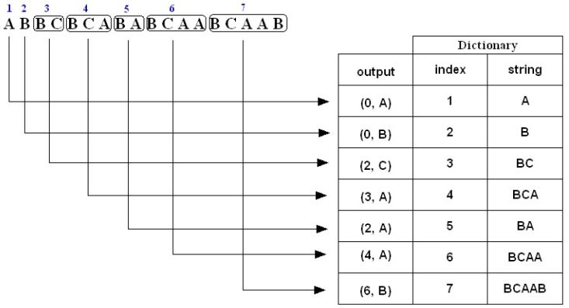
Example 1: LZ78 Compression
Encode (i.e., compress) the string ABBCBCABABCAABCAAB using the LZ78 algorithm.
The compressed message is: (0,A)(0,B)(2,C)(3,A)(2,A)(4,A)(6,B)
Note: The above is just a representation, the commas and parentheses are not transmitted; we will discuss the actual form of the compressed message later on in slide 12.

Slide 28
Example 1: LZ78 Compression (cont’d)
1. A is not in the Dictionary; insert it
2. B is not in the Dictionary; insert it
3. B is in the Dictionary.
BC is not in the Dictionary; insert it.
4. B is in the Dictionary.
BC is in the Dictionary.
BCA is not in the Dictionary; insert it.
5. B is in the Dictionary.
BA is not in the Dictionary; insert it.
6. B is in the Dictionary.
BC is in the Dictionary.
BCA is in the Dictionary.
BCAA is not in the Dictionary; insert it.
7. B is in the Dictionary.
BC is in the Dictionary.
BCA is in the Dictionary.
BCAA is in the Dictionary.
BCAAB is not in the Dictionary; insert it.

Slide 29
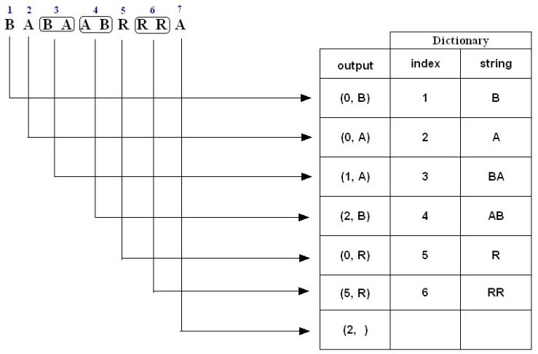
Example 2: LZ78 Compression
Encode (i.e., compress) the string BABAABRRRA using the LZ78 algorithm.
The compressed message is: (0,B)(0,A)(1,A)(2,B)(0,R)(5,R)(2, )

Slide 30
Example 2: LZ78 Compression (cont’d)
1. B is not in the Dictionary; insert it
2. A is not in the Dictionary; insert it
3. B is in the Dictionary.
BA is not in the Dictionary; insert it.
4. A is in the Dictionary.
AB is not in the Dictionary; insert it.
5. R is not in the Dictionary; insert it.
6. R is in the Dictionary.
RR is not in the Dictionary; insert it.
7. A is in the Dictionary and it is the last input character; output a pair
containing its index: (2, )

Slide 31
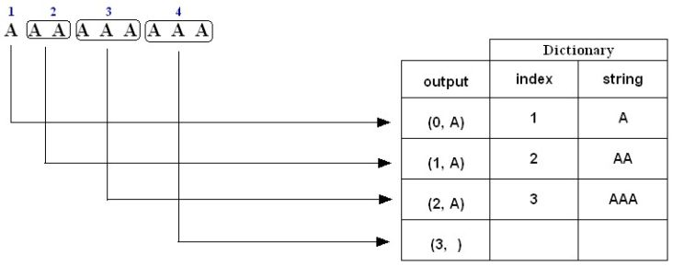
Example 3: LZ78 Compression
Encode (i.e., compress) the string AAAAAAAAA using the LZ78 algorithm.
1. A is not in the Dictionary; insert it
2. A is in the Dictionary
AA is not in the Dictionary; insert it
3. A is in the Dictionary.
AA is in the Dictionary.
AAA is not in the Dictionary; insert it.
4. A is in the Dictionary.
AA is in the Dictionary.
AAA is in the Dictionary and it is the last pattern; output a pair containing its index:
(3, )

Slide 32
LZ78 Decompression Algorithm
Dictionary ← empty ; DictionaryIndex ← 1 ;
while(there are more (CodeWord, Char) pairs in codestream){
CodeWord ← next CodeWord in codestream ;
Char ← character corresponding to CodeWord ;
if(CodeWord = = 0)
String ← empty ;
else
String ← string at index CodeWord in Dictionary ;
Output: String + Char ;
insertInDictionary( (DictionaryIndex , String + Char) ) ;
DictionaryIndex++;
}
Summary:
input: (CW, character) pairs
output:
if(CW == 0)
output: currentCharacter
else
output: stringAtIndex CW + currentCharacter
Insert: current output in dictionary

Slide 33
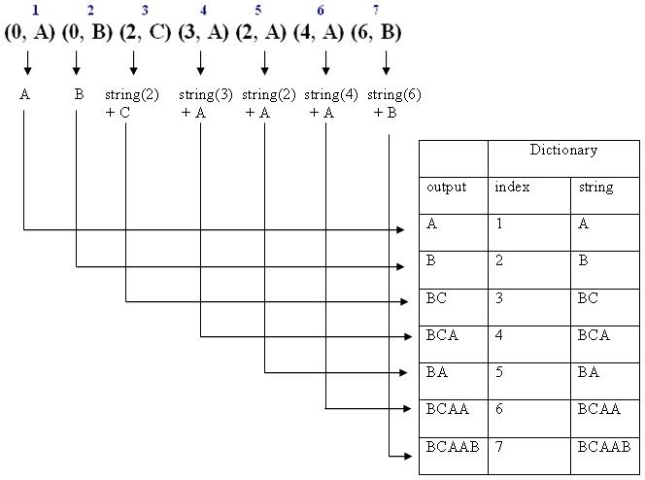
Example 1: LZ78 Decompression
Decode (i.e., decompress) the sequence (0, A) (0, B) (2, C) (3, A) (2, A) (4, A) (6, B)
The decompressed message is: ABBCBCABABCAABCAAB

Slide 34
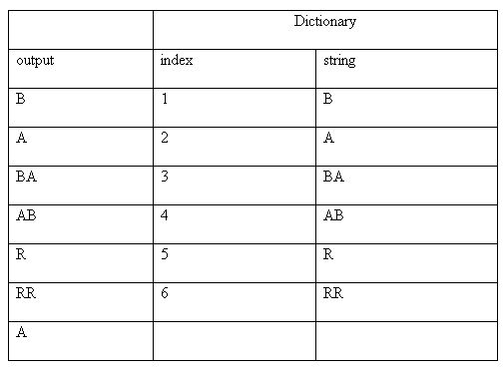
Example 2: LZ78 Decompression
Decode (i.e., decompress) the sequence (0, B) (0, A) (1, A) (2, B) (0, R) (5, R) (2, )
The decompressed message is: BABAABRRRA

Slide 35
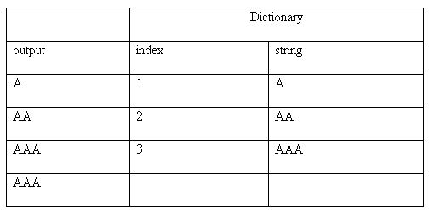
Example 3: LZ78 Decompression
Decode (i.e., decompress) the sequence (0, A) (1, A) (2, A) (3, )
The decompressed message is: AAAAAAAAA

Slide 36
Exercises
1. Use LZ78 to trace encoding the string
SATATASACITASA.
2. Write a Java program that encodes a given string using LZ78.
3. Write a Java program that decodes a given set of encoded codewords using LZ78.

Slide 37
LZW Encoding Algorithm
If the message to be encoded consists of only one character, LZW outputs the
code for this character; otherwise it inserts two- or multi-character, overlapping*,
distinct patterns of the message to be encoded in a Dictionary.
*The last character of a pattern is the first character of the next pattern.
The patterns are of the form: C₀C₁ . . . C_{n-1}C_{n}. The prefix of a pattern consists of all the pattern characters except the last: C₀C₁ . . . C_{n-1}
LZW output if the message consists of more than one character:
If the pattern is not the last one; output: The code for its prefix.
If the pattern is the last one:
if the last pattern exists in the Dictionary; output: The code for the pattern.
If the last pattern does not exist in the Dictionary; output: code(lastPrefix) then
output: code(lastCharacter)
Note: LZW outputs codewords that are 12-bits each. Since there are 2¹² = 4096 codeword possibilities, the minimum size of the Dictionary is 4096; however since the Dictionary is usually implemented as a hash table its size is larger than 4096.

Slide 38
LZW Encoding Algorithm (cont’d)
Initialize Dictionary with 256 single character strings and their corresponding ASCII codes;
Prefix ← first input character;
CodeWord ← 256;
while(not end of character stream){
Char ← next input character;
if(Prefix + Char exists in the Dictionary)
Prefix ← Prefix + Char;
else{
Output: the code for Prefix;
insertInDictionary( (CodeWord , Prefix + Char) ) ;
CodeWord++;
Prefix ← Char;
}
}
Output: the code for Prefix;

Slide 39

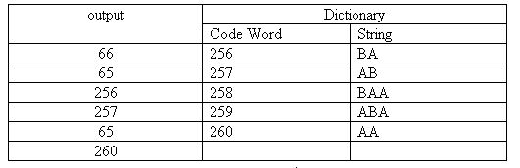
Example 1: Compression using LZW
Encode the string BABAABAAA by the LZW encoding algorithm.
1. BA is not in the Dictionary; insert BA, output the code for its prefix: code(B)
2. AB is not in the Dictionary; insert AB, output the code for its prefix: code(A)
3. BA is in the Dictionary.
BAA is not in Dictionary; insert BAA, output the code for its prefix: code(BA)
4. AB is in the Dictionary.
ABA is not in the Dictionary; insert ABA, output the code for its prefix: code(AB)
5. AA is not in the Dictionary; insert AA, output the code for its prefix: code(A)
6. AA is in the Dictionary and it is the last pattern; output its code: code(AA)
The compressed message is: <66><65><256><257><65><260>

Slide 40

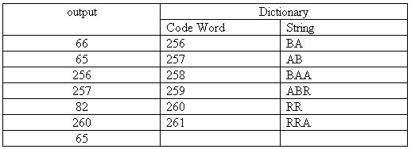
Example 2: Compression using LZW
Encode the string BABAABRRRA by the LZW encoding algorithm.
1. BA is not in the Dictionary; insert BA, output the code for its prefix: code(B)
2. AB is not in the Dictionary; insert AB, output the code for its prefix: code(A)
3. BA is in the Dictionary.
BAA is not in Dictionary; insert BAA, output the code for its prefix: code(BA)
4. AB is in the Dictionary.
ABR is not in the Dictionary; insert ABR, output the code for its prefix: code(AB)
5. RR is not in the Dictionary; insert RR, output the code for its prefix: code(R)
6. RR is in the Dictionary.
RRA is not in the Dictionary and it is the last pattern; insert RRA, output code for its prefix:
code(RR), then output code for last character: code(A)
The compressed message is: <66><65><256><257><82><260> <65>

Slide 41
LZW Decoding Algorithm
The LZW decompressor creates the same string table during decompression.
Initialize Dictionary with 256 ASCII codes and corresponding single character strings as their translations;
PreviousCodeWord ← first input code;
Output: string(PreviousCodeWord) ;
Char ← character(first input code);
CodeWord ← 256;
while(not end of code stream){
CurrentCodeWord ← next input code ;
if(CurrentCodeWord exists in the Dictionary)
String ← string(CurrentCodeWord) ;
else
String ← string(PreviousCodeWord) + Char ;
Output: String;
Char ← first character of String ;
insertInDictionary( (CodeWord , string(PreviousCodeWord) + Char ) );
PreviousCodeWord ← CurrentCodeWord ;
CodeWord++ ;
}

Slide 42
LZW Decoding Algorithm (cont’d)
Summary of LZW decoding algorithm:
output: string(first CodeWord);
while(there are more CodeWords){
if(CurrentCodeWord is in the Dictionary)
output: string(CurrentCodeWord);
else
output: PreviousOutput + PreviousOutput first character;
insert in the Dictionary: PreviousOutput + CurrentOutput first character;
}

Slide 43
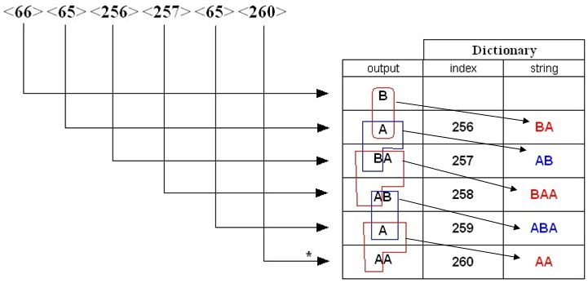
Example 1: LZW Decompression
Use LZW to decompress the output sequence <66> <65> <256> <257> <65> <260>
66 is in Dictionary; output string(66) i.e. B
65 is in Dictionary; output string(65) i.e. A, insert BA
256 is in Dictionary; output string(256) i.e. BA, insert AB
257 is in Dictionary; output string(257) i.e. AB, insert BAA
65 is in Dictionary; output string(65) i.e. A, insert ABA
260 is not in Dictionary; output
previous output + previous output first character: AA, insert AA

Slide 44
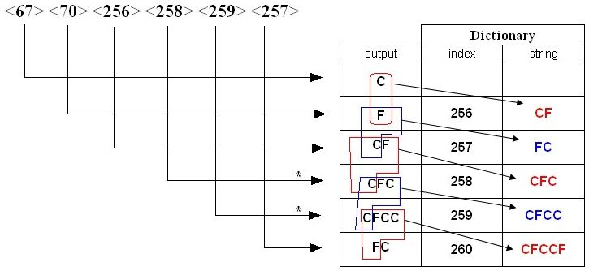
Example 2: LZW Decompression
Decode the sequence <67> <70> <256> <258> <259> <257> by LZW decode algorithm.
67 is in Dictionary; output string(67) i.e. C
70 is in Dictionary; output string(70) i.e. F, insert CF
256 is in Dictionary; output string(256) i.e. CF, insert FC
258 is not in Dictionary; output previous output + C i.e. CFC, insert CFC
259 is not in Dictionary; output previous output + C i.e. CFCC, insert CFCC
257 is in Dictionary; output string(257) i.e. FC, insert CFCCF

Slide 45
LZW: Limitations
What happens when the dictionary gets too large?
One approach is to clear entries 256-4095 and start building the dictionary again.
The same approach must also be used by the decoder.

Slide 46
Exercises
Use LZW to trace encoding the string ABRACADABRA

